Slide 1
A World of Possibilities with CTE
Be amazed at what Chino High CTE teachers offer our students!

Slide 2
CTE Library Science Dorinda Sullivan, District Librarian
Offering students skills in the workings of public school libraries, shelving, circulation, and customer service skills!
4 11th/12th grade students per period (maximum of 5 per approval)
4th or 5th period prep if possible
Resumes, career exploration, essays, lab hours, Dewey Decimal, content analysis, novel, technology instruction!

Slide 3
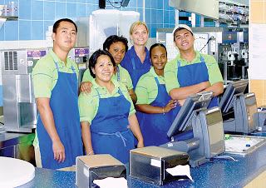
Work Experience
This Photo by Unknown author is licensed under CC BY-NC-ND.
Students enrolled in WEE earn credits will learning 'real-world' skills within the curriculum
Income Tax instruction
Mock Interview project
WEE Coordinator monitors progress for students' jobs or volunteer placements
Job site visits, supervisor contacts
Monitor balance between job demands/academic progress

Slide 4
CH MP
Culinary​
Hospitality​
​
​
Management​
Pathway
Explore new foods
Connect academics to your passion
Acquire technical skills
Earn industry certifications
Receive A- G Elective Credit
Utilize AVID Strategies
Be Business ready
Advance to college and careers!!

Slide 5
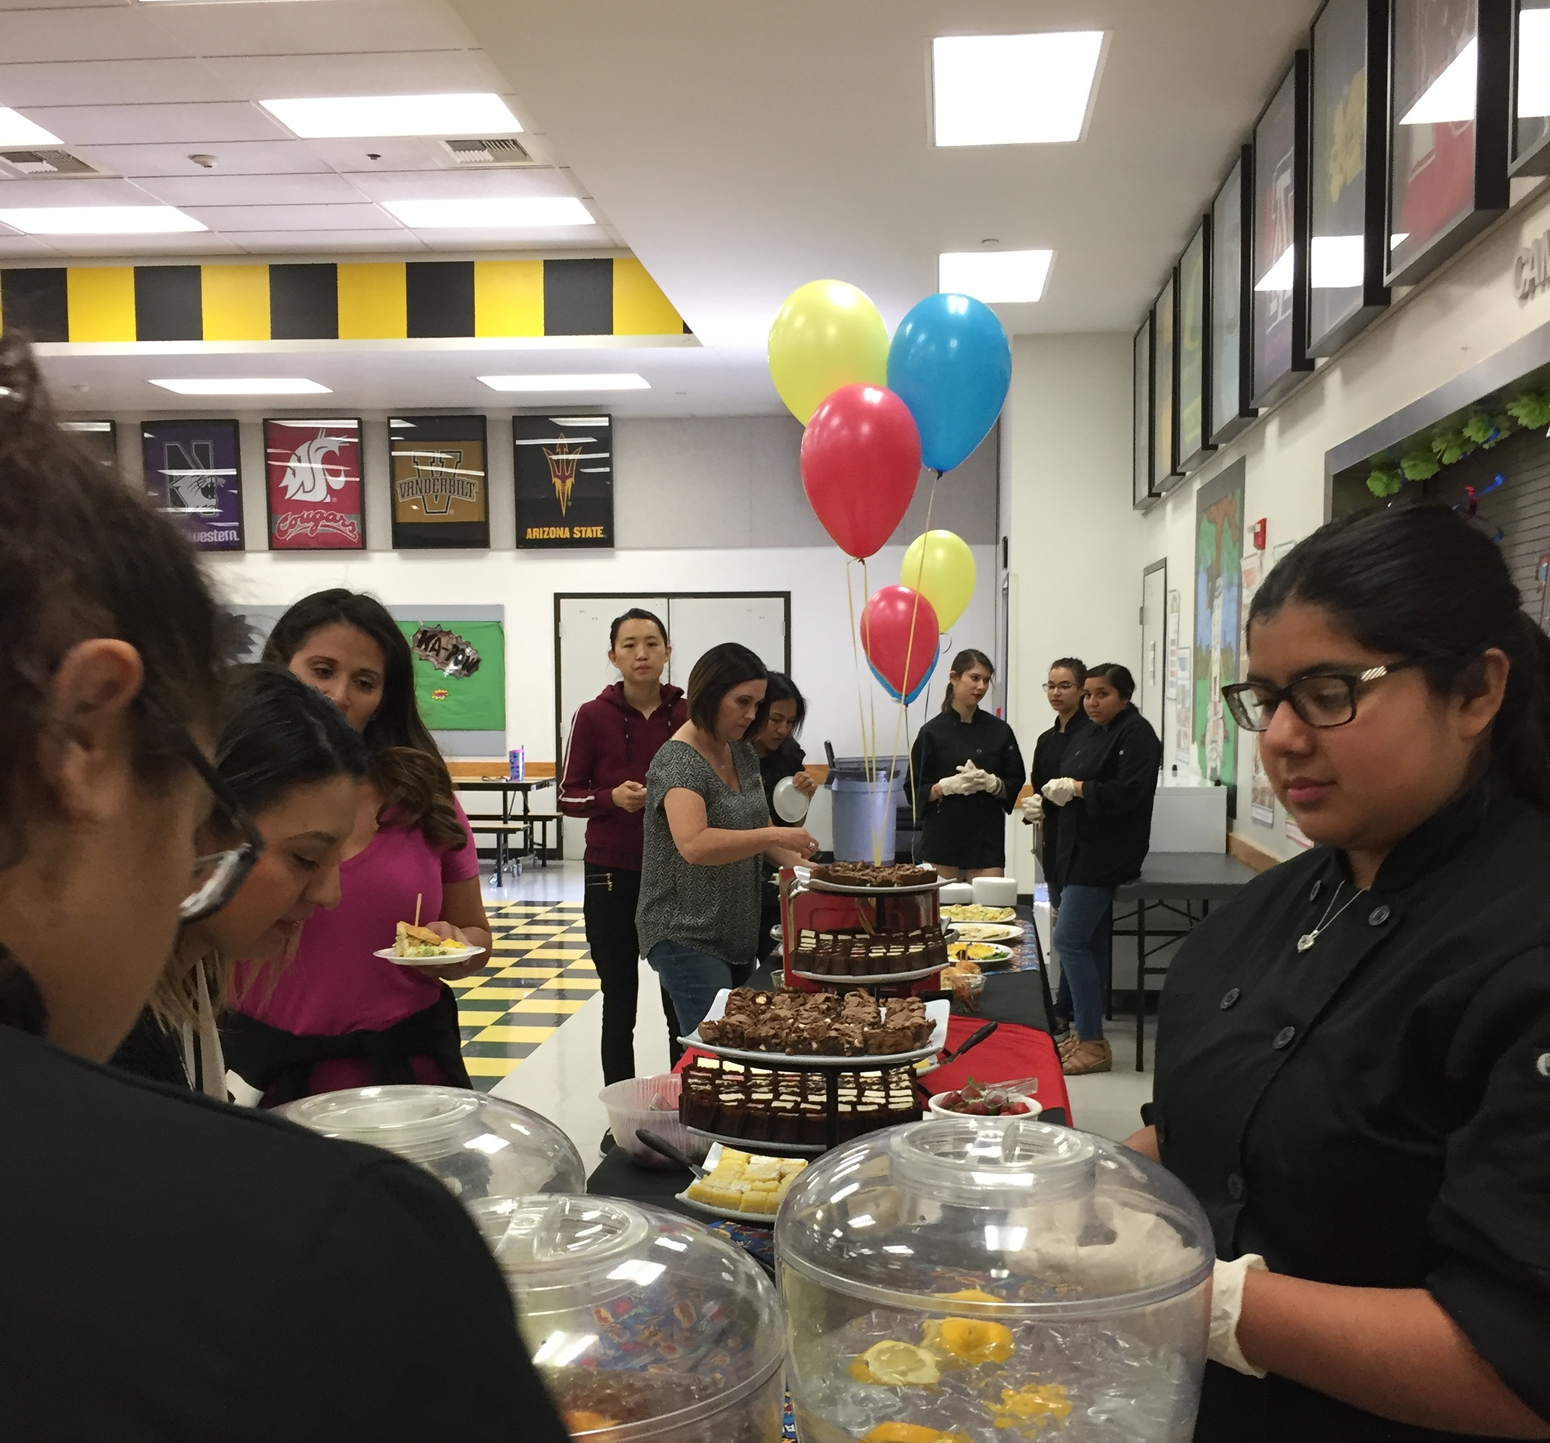
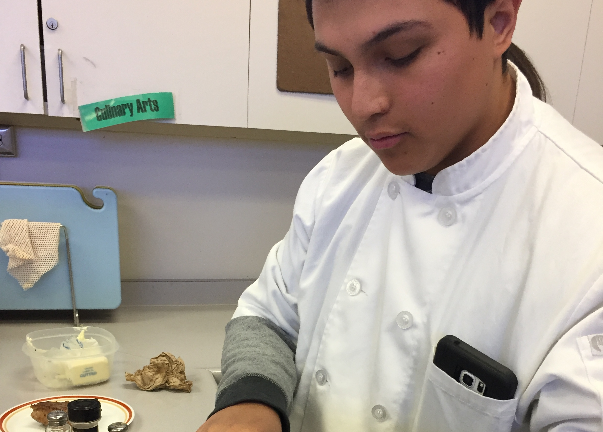
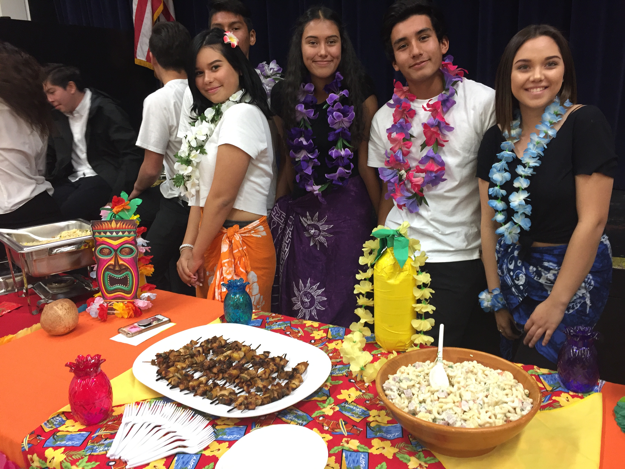

Slide 6
CTE Industry Sector – HTR Hospitality, Tourism & Recreation Completion of pathway classes with a "B"or better students can receive a career cord for graduation. With active leadership participation in FCCLA students can earn a red cord for graduation.
International Foods
Culinary Arts 1
Culinary Arts 2
10th Grade
Focus on Introductory Cooking
Exploring Spices and Herbs
Regional Soups & Salads
International Country Reports
Leadership Training - FCCLA
11th Grade
Focus on food preparation for the hospitality industry
Advanced cooking skills
Equipment use and care
Food Handlers Card opportunity
Force in Training (FIT) Certificate from the California Rest Assoc.
Leadership Roles in FCCLA
12th Grade
Focus on Industry Catering skills
Advanced Main Dishes and Creative Desserts
Business Training Certificates
Leadership Activities within Region, State and National Organization

Slide 7
Teacher: Alex Edwards

Slide 8
No prerequisites for the Fall semester
Teacher: Alex Edwards

Slide 9
Teacher: Alex Edwards

Slide 10
Teacher: Alex Edwards

Slide 11
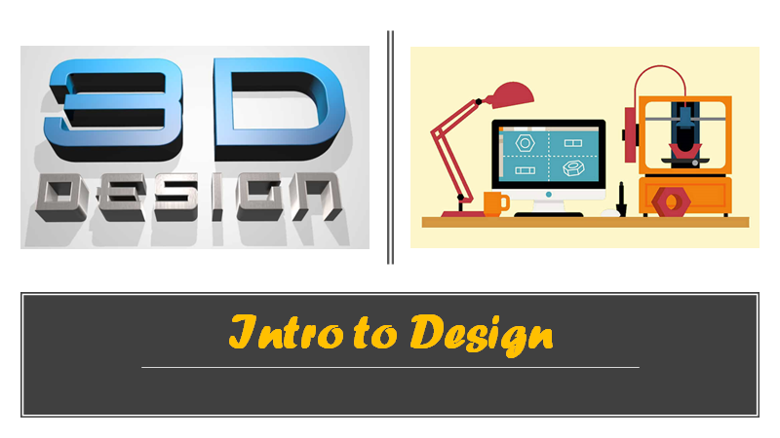
Introduction to design gives students the opportunity to develop skills and understanding of three-dimensional graphic design and 3D printing process concepts.
Students use a 3D solid modeling design software and 3D printers to help them design 3D model concepts (prototypes)
This class is for students interested in any career related to:
Engineering/design
Animation and design
Biomedical technology
3d design
3d printing specialist
3d customization & prototyping
Product development.
Two semester Class: 5 credits per semester/10 credits total
Meets the UC/CSU “f” Visual Performing Arts requirement
No prerequisites for the Fall semester
.
Teacher: Alex Edwards

